Slide 1
Learning Objective
I will be able apply Pascal’s Triangle to determine the coefficient of binomial expansions
Success Criteria
At the end of the lesson, I will be able to:
understand what is Pascal’s Triangle and apply it to determine the coefficient of binomial expansions;
understand the significance of Pascal’s triangle to the number of possible combinations;
identify some properties of Pascal’s Triangle

Slide 2
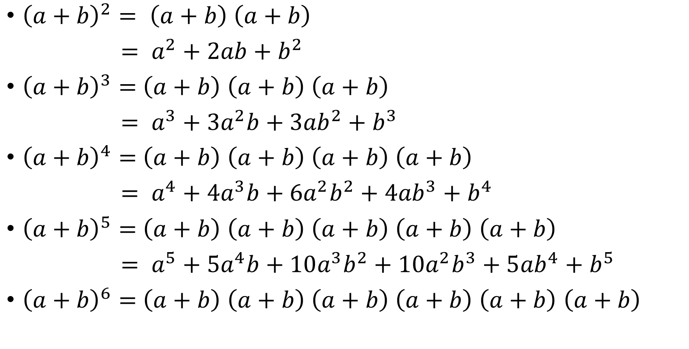
Expand the following
Activating Prior Knowledge
${\left(a+b\right)}^{2}= \left(a+b\right)$ $\left(a+b\right)$
$= a^{2}+2ab+b^{2}$
${\left(a+b\right)}^{3}=$ $\left(a+b\right)$ $\left(a+b\right)$ $\left(a+b\right)$
$= a^{3}+3a^{2}b+3{ab}^{2}+b^{3}$
${\left(a+b\right)}^{4}=$ $\left(a+b\right)$ $\left(a+b\right)$ $\left(a+b\right)$ $\left(a+b\right)$
$= a^{4}+4a^{3}b+6{a^{2}b}^{2}+4{ab}^{3}+$ $b^{4}$
${\left(a+b\right)}^{5}=$ $\left(a+b\right)$ $\left(a+b\right)$ $\left(a+b\right)$ $\left(a+b\right)$ $\left(a+b\right)$
$= a^{5}+5a^{4}b+10{a^{3}b}^{2}+10{a^{2}b}^{3}+5{ab}^{4}+$ $b^{5}$
${\left(a+b\right)}^{6}=$ $\left(a+b\right)$ $\left(a+b\right)$ $\left(a+b\right)$ $\left(a+b\right)$ $\left(a+b\right)$ $\left(a+b\right)$

Slide 3
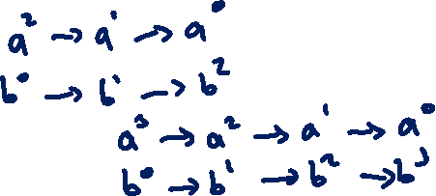
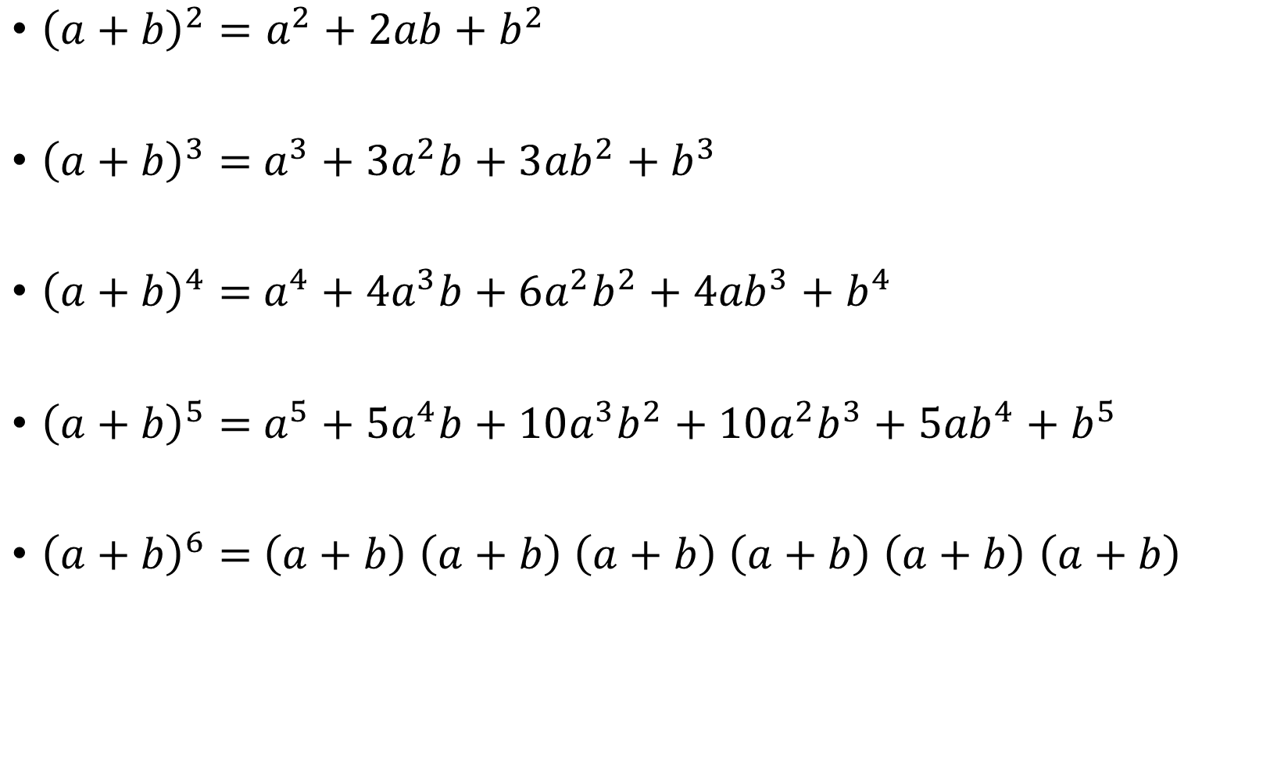
Activating Prior Knowledge
${\left(a+b\right)}^{2}=a^{2}+2ab+b^{2}$
${\left(a+b\right)}^{3}=$ $a^{3}+3a^{2}b+3{ab}^{2}+b^{3}$
${\left(a+b\right)}^{4}=$ $a^{4}+4a^{3}b+6{a^{2}b}^{2}+4{ab}^{3}+$ $b^{4}$
${\left(a+b\right)}^{5}=$ $a^{5}+5a^{4}b+10{a^{3}b}^{2}+10{a^{2}b}^{3}+5{ab}^{4}+$ $b^{5}$
${\left(a+b\right)}^{6}=$ $\left(a+b\right)$ $\left(a+b\right)$ $\left(a+b\right)$ $\left(a+b\right)$ $\left(a+b\right)$ $\left(a+b\right)$
$$=a^{6}b^{0}+6a^{5}b^{1}+15a^{4}b^{2}+20a^{3}b^{3}+15a^{2}b^{4}+6a^{1}b^{5}+a^{0}b^{6}$$
$$=a^{6}+6a^{5}b^{ }+15a^{4}b^{2}+20a^{3}b^{3}+15a^{2}b^{4}+6a^{ }b^{5}+b^{6}$$

Slide 4
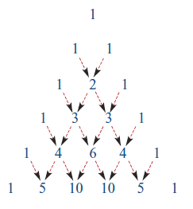



























Pascal’s Triangle
$$n=0$$
$${{}_{ }^{0}C}_{0}$$
$$n=1$$
$${{}_{ }^{1}C}_{0}$$
$${{}_{ }^{1}C}_{1}$$
$${{}_{ }^{2}C}_{0}$$
$${{}_{ }^{2}C}_{1}$$
$${{}_{ }^{2}C}_{2}$$
$$n=2$$
$$n=3$$
$${{}_{ }^{3}C}_{0}$$
$${{}_{ }^{3}C}_{1}$$
$${{}_{ }^{3}C}_{2}$$
$${{}_{ }^{3}C}_{3}$$
$${{}_{ }^{4}C}_{0}$$
$${{}_{ }^{4}C}_{1}$$
$${{}_{ }^{4}C}_{2}$$
$${{}_{ }^{4}C}_{3}$$
$${{}_{ }^{4}C}_{4}$$
$$n=4$$
$$n=5$$
$${{}_{ }^{5}C}_{0}$$
$${{}_{ }^{5}C}_{1}$$
$${{}_{ }^{5}C}_{2}$$
$${{}_{ }^{5}C}_{3}$$
$${{}_{ }^{5}C}_{4}$$
$${{}_{ }^{5}C}_{5}$$

Slide 5
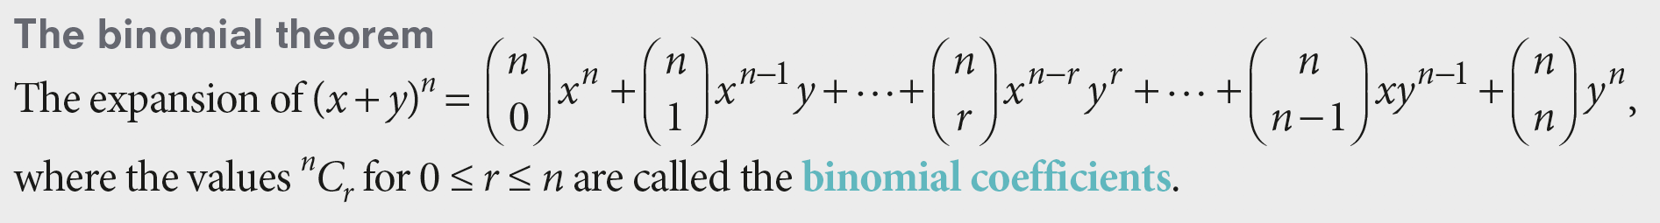
Combining Pascal’s Triangle with Binomial Expansions – The binomial Theorem
Concept Development

Slide 6


Expand ${(x+2)}^{4}$
Guided Practice
${(x)}^{4}+\left({4 \atop 1}\right)$ ${\left(x\right)}^{3}\left(2\right)+\left({4 \atop 2}\right) {\left(x\right)}^{2}{\left(2\right)}^{2}+\left({4 \atop 3}\right) (x){\left(2\right)}^{3}+{\left(2\right)}^{4}$
$${(x+2)}^{4}=$$
$=x^{4}+4\left(x^{3}\right)\left(2\right)+6\left(x^{2}\right)\left(4\right)+4\left(x\right)\left(8\right)+16$
$$=x^{4}+8x^{3}+24x^{2}+32x+16$$

Slide 7

Expand ${(3x+2y)}^{4}$
Guided Practice
$${(3x+2y)}^{4}$$
$={(3x)}^{4}+\left({4 \atop 1}\right)$ ${\left(3x\right)}^{3}\left(2y\right)+\left({4 \atop 2}\right) {\left(3x\right)}^{2}{\left(2y\right)}^{2}+\left({4 \atop 3}\right) (3x){\left(2y\right)}^{3}+{\left(2y\right)}^{4}$
$=81x^{4}+4\left(27x^{3}\right)\left(2y\right)+6\left(9x^{2}\right)\left(4y^{2}\right)$ $+4\left(3x\right)\left(8y^{3}\right)+16y^{4}$
$$=81x^{4}+216x^{3}y+216x^{2}y^{2}+96xy^{3}+16y^{4}$$

Slide 8

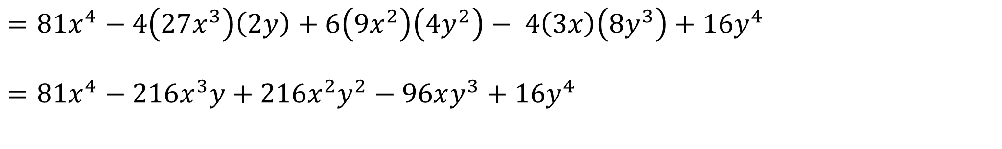
Expand ${(3x−2y)}^{4}$
Guided Practice
$${(3x−2y)}^{4}$$
$={(3x)}^{4}+\left({4 \atop 1}\right)$ ${\left(3x\right)}^{3}\left(−2y\right)+\left({4 \atop 2}\right) {\left(3x\right)}^{2}{\left(−2y\right)}^{2}+\left({4 \atop 3}\right) (3x){\left(−2y\right)}^{3}+{\left(−2y\right)}^{4}$
$$=81x^{4}−4\left(27x^{3}\right)\left(2y\right)+6\left(9x^{2}\right)\left(4y^{2}\right)− 4\left(3x\right)\left(8y^{3}\right)+16y^{4}$$
$$=81x^{4}−216x^{3}y+216x^{2}y^{2}−96xy^{3}+16y^{4}$$

Slide 9


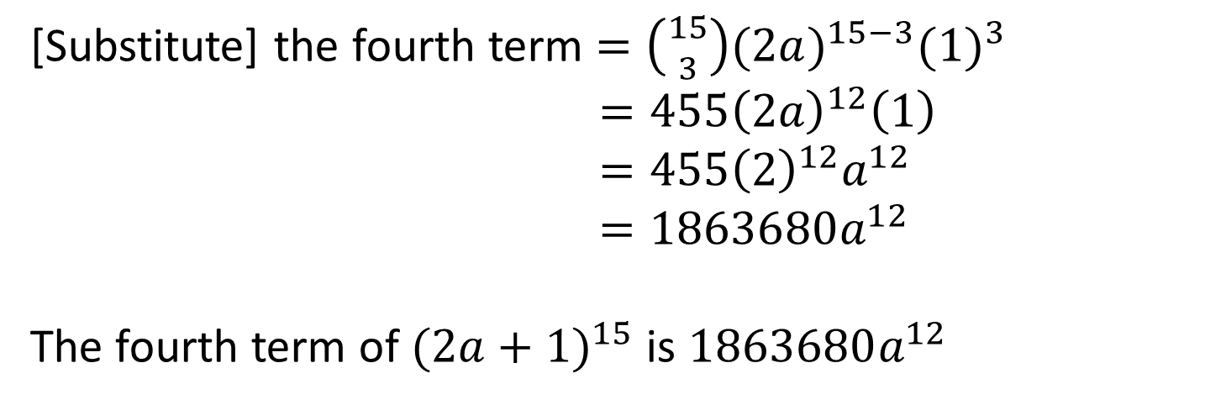
Find the fourth term ${(2a+1)}^{15}$
Guided Practice
In binomial expansion
the fourth term is $\left({n \atop 3}\right)x^{n−3}y^{3}$
We know that $n=15, x=2a and y=1$
[Substitute] the fourth term $=\left({15 \atop 3}\right){(2a)}^{15−3}{(1)}^{3}$
$=455{\left(2a\right)}^{12}\left(1\right)$
$=455{\left(2\right)}^{12}a^{12}$
$=1863680a^{12}$
The fourth term of ${(2a+1)}^{15}$ is $1863680a^{12}$

Slide 10


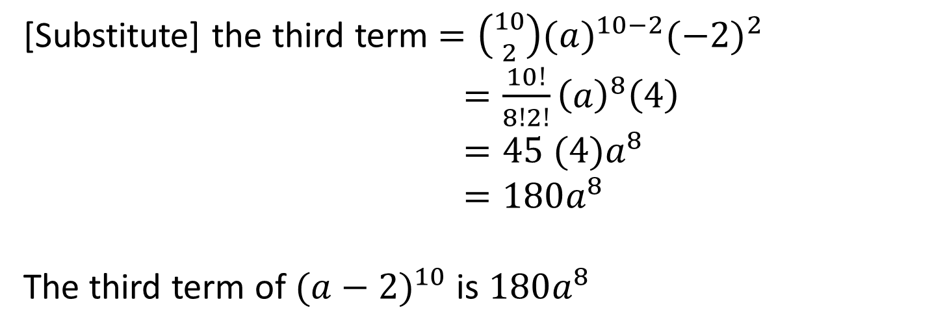
Without a calculator find the 3rd term ${(a−2)}^{10}$
Guided Practice
In binomial expansion
the third term is $\left({n \atop 2}\right)x^{n−2}y^{2}$
We know that $n=10, x=a and y=−2$
[Substitute] the third term $=\left({10 \atop 2}\right){(a)}^{10−2}{(−2)}^{2}$
$=\frac{10!}{8!2!}{\left(a\right)}^{8}\left(4\right)$
$=45 (4)a^{8}$
$=180a^{8}$
The third term of ${(a−2)}^{10}$ is $180a^{8}$

Slide 11
Independent Practice
Complete Ex 10E

